Slide 1

project7——Real Estate Property Management System
Faculty Adviser： Lilia SFAXI
Students： PengChuHan MaSiXi
ZhangMingYang NieXiaoYa

Slide 2
CONTENTS
01
Introduction
04
GUI & Visualization
02
Core Algorithms & Design
05
Testing & Robustness
03
Optimization & Extensibility

Slide 3
Introduction
Goal
To build an efficient and extensible real estate management system for effective property & client management, dynamic data analysis, and smart matching.
Main Features
Tech Stack
Data Modeling: Property & Client Classes
Efficient Storage & Query: AVL Tree (Self-balancing BST)
Client Request Queue Management
Graphical Interface & Data Visualization
Comprehensive Unit Test Coverage
Python
PyQt5 (GUI)
Matplotlib (Data Visualization)
Data Structures: AVL Tree & Queue

Slide 4
Introduction
System Architecture
Project Directory Structure
Modular design with clear separation of concerns, easy to maintain and extend.
real_estate_project/
real_estate/
GUI Layer
interface.py, PyQt5, Matplotlib
models/
structures/
managers/
Managers Layer
property_manager.py, client_manager.py
Managers coordinate business logic, separating GUI from underlying data structures
utils/
gui/
Structures Layer
avl_tree.py, client_queue.py
tests/
datasets/
Models Layer
property.py, client.py
main.py
Each layer only interacts with its direct dependencies, ensuring modularity and maintainability
README.md
Utils / Datasets Layer
loader.py, datasets/*.csv
requirements.txt

Slide 5
Introduction
Sample Use Case Flow
01
02
03
04
System matches suitable property to client
Client purchases property, data/status auto-updated
Agent adds property
Client submits request
Why AVL Tree & Queue?
Data Structure | Key Business Operation | Time Complexity | Space Complexity | No Data Redundancy | Business Rationale
AVL Tree | Property insert/search/delete | O(log N) | O(N) | ✔️ | Efficient for large-scale property listings, ensures all CRUD operations are fast and the tree remains balanced.
Queue | Client enqueue/dequeue | O(1) | O(N) | ✔️ | Manages client requests in strict FIFO order, with no duplicate nodes or wasted memory.

Slide 6
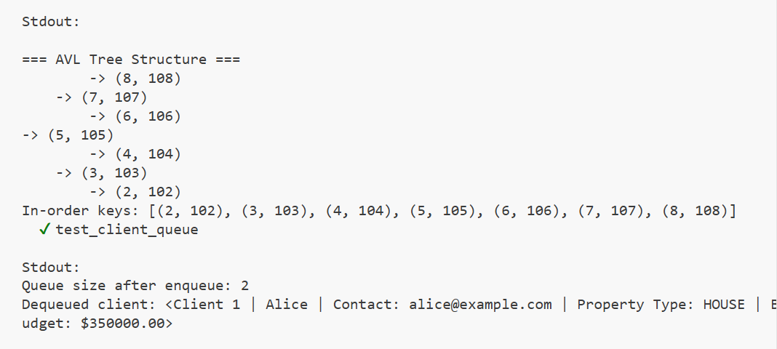
Core Algorithms & Design
Data Structures
Design Choices:
1. Classic structures for speed & scalability.
2. Strong typing and separation for robust, maintainable code.
Property Class
Stores property info: property_ID, address, price, type, status, owner.
Enums ensure valid types/status; supports analytics (views, inquiries).
Implements comparison methods for efficient tree operations.
Client Class
Stores client info: client_ID, name, budget, type, preferences.
Designed for smart matching and easy expansion
AVL Tree
Self-balancing BST for fast property storage/search (O(log n)).
Unique (price, property_ID) key prevents duplicates.
Supports insert, delete, search by ID or price range.
AVL Tree Visualization (from Unit Test Output)
ClientQueue
the balanced structure of the AVL tree after insertion, confirming tree balancing.
The in-order keys confirm that the data structure preserves correct ordering.
The queue test demonstrates enqueue and dequeue operations, matching expected results.
√
√
FIFO queue for managing client requests.
No duplicate IDs; supports fast enqueue/dequeue and inspection
√

Slide 7
Core Algorithms & Design
Key Algorithm Workflow
AVL Trees guarantee balanced structure for worst-case efficient operations
Property CRUD Operations with AVL Tree
Insert: Each property is inserted into the AVL tree using a (price, property_ID) key, ensuring O(log n) insertion and preventing duplicate records.
Delete: Properties are efficiently removed while maintaining tree balance, ensuring data consistency and speed.
Search: Fast search by ID or by price range, using tree traversal and comparison methods.
01
Client Request Handling with Queue
Queueing ensures fairness and a predictable service order
Enqueue/Dequeue: Clients are added/removed in a strict FIFO order; duplicate IDs are automatically skipped.
Peek/Move-to-Rear: Allows inspection and fair cycling of client requests.
02

Slide 8

Core Algorithms & Design
Business Logic in Managers
PropertyManager
ClientManager
AVL Tree
Client Queue
Encapsulates AVL Tree for property storage, addition, deletion, and efficient range/criteria queries.
Ensures Data Integrity: Status updates enforce business rules (e.g., SOLD properties must have owners).
Supports Dynamic Pricing: Adjusts property prices in real time based on views/inquiries (simple smart pricing)
Manages Client Queue: Handles client addition/removal, ensuring FIFO processing.
Smart Matching: Matches clients to properties by type, budget, location, and features with a weighted scoring algorithm.
Transactional Operations: Automatic property purchase: assigns ownership, updates status, and deducts client budget.
03
04

Slide 9

Optimization & Extensibility
5.
Optimized Property Matching
✅ Completed Optimizations
develop a more complex property matching system for clients based on multiple criteria and preferences.
1.
Eliminated Data Redundancy
√
×
dual storage (dict + AVLTree)
AVLTree
6.
Higher Code Coverage
2.
Improved Queue Logic
Added edge-case unit tests and data structure visual tests for robustness and transparency.
×
dequeue–enqueue cycles
using pointer tracking
√
3.
Smarter Property Selection Logic
Future Extensions
×
client buy properties in order
prioritize cheapest
√
External API Integration
4.
Dynamic Pricing Model
AI-Based Recommendations
adjust property prices according to supply and demand conditions
Notification System

Slide 10
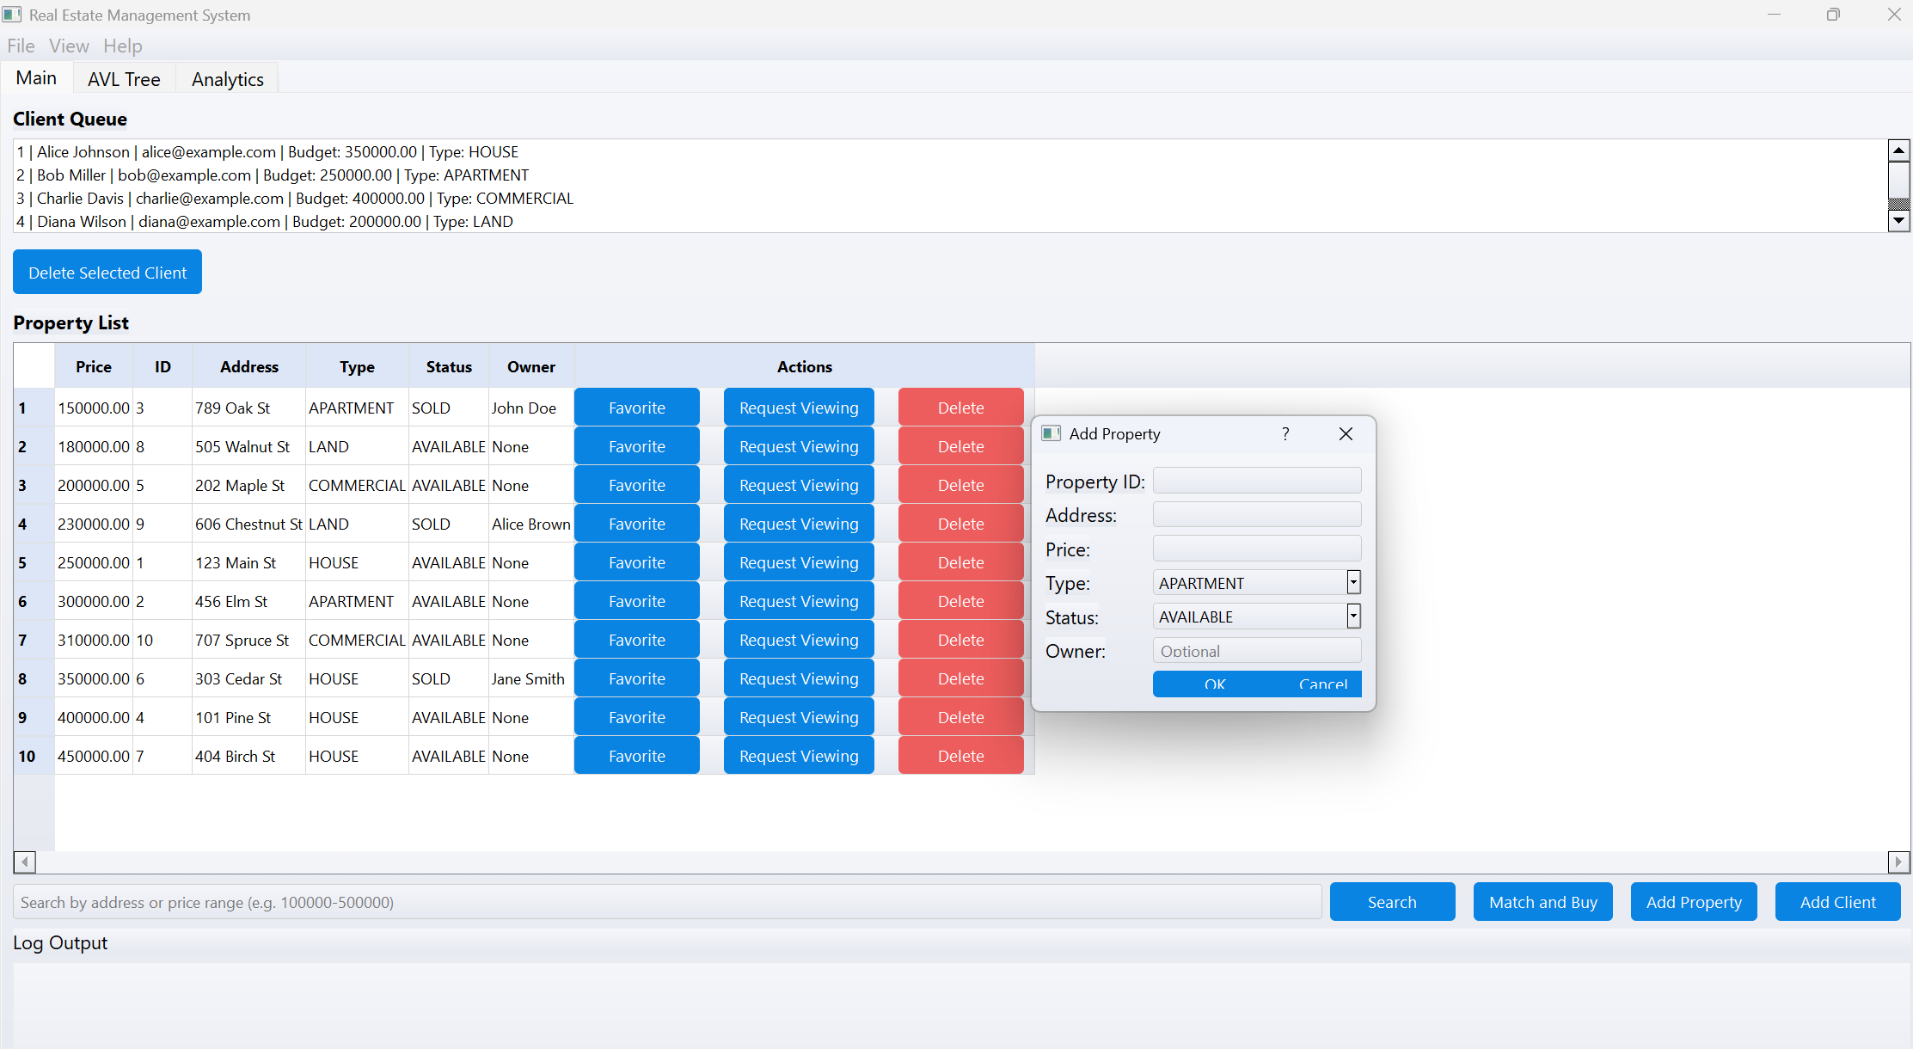
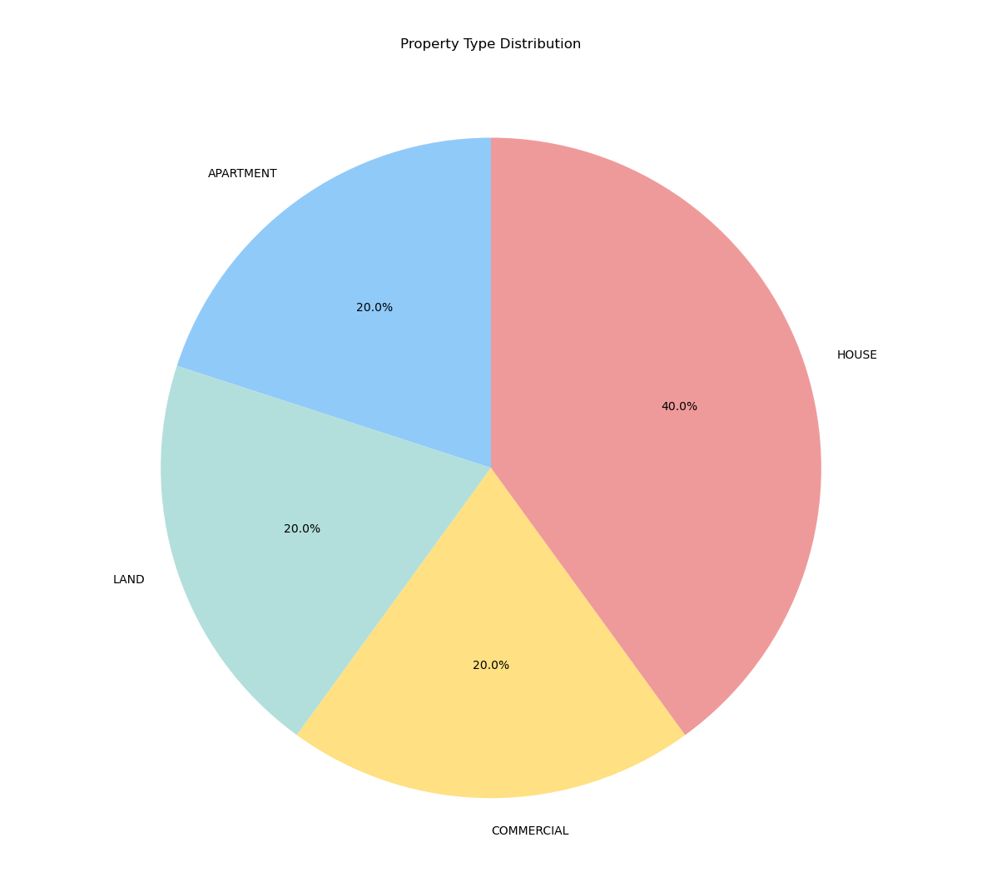
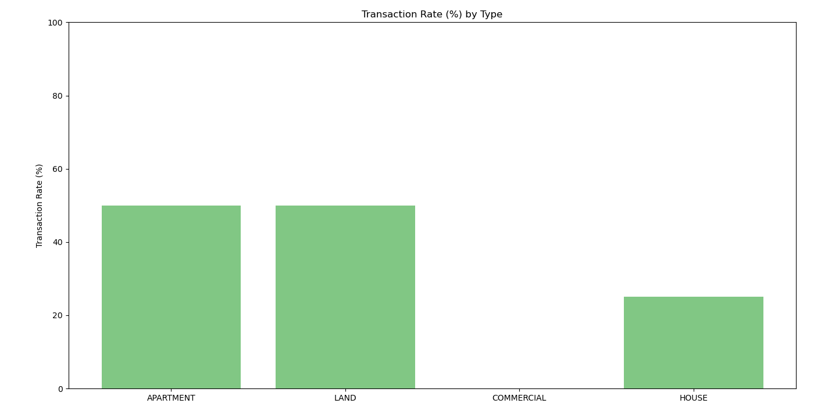
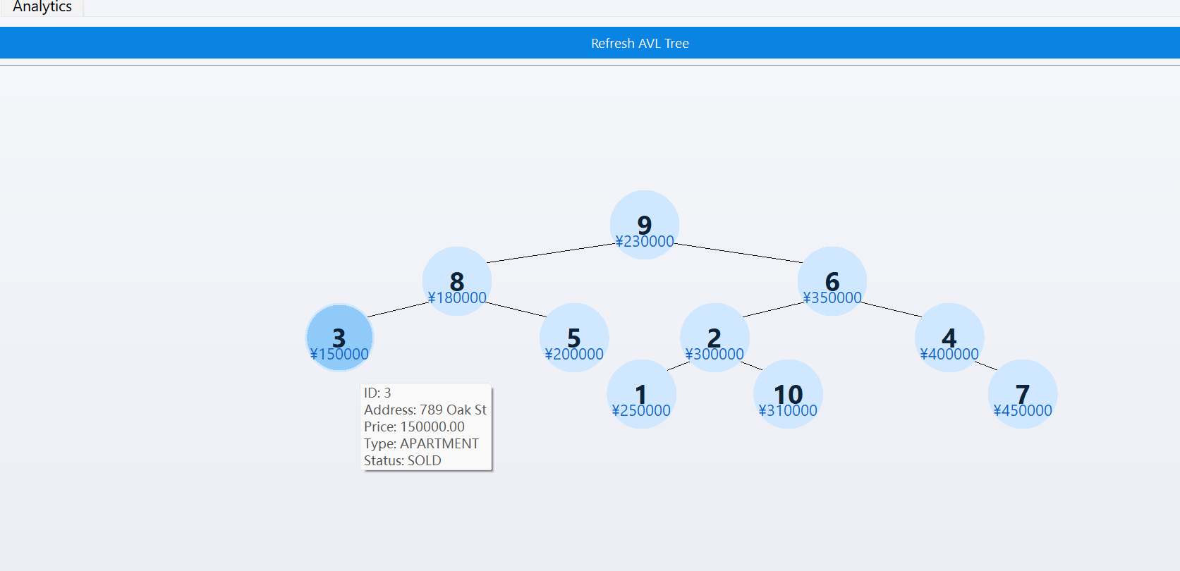
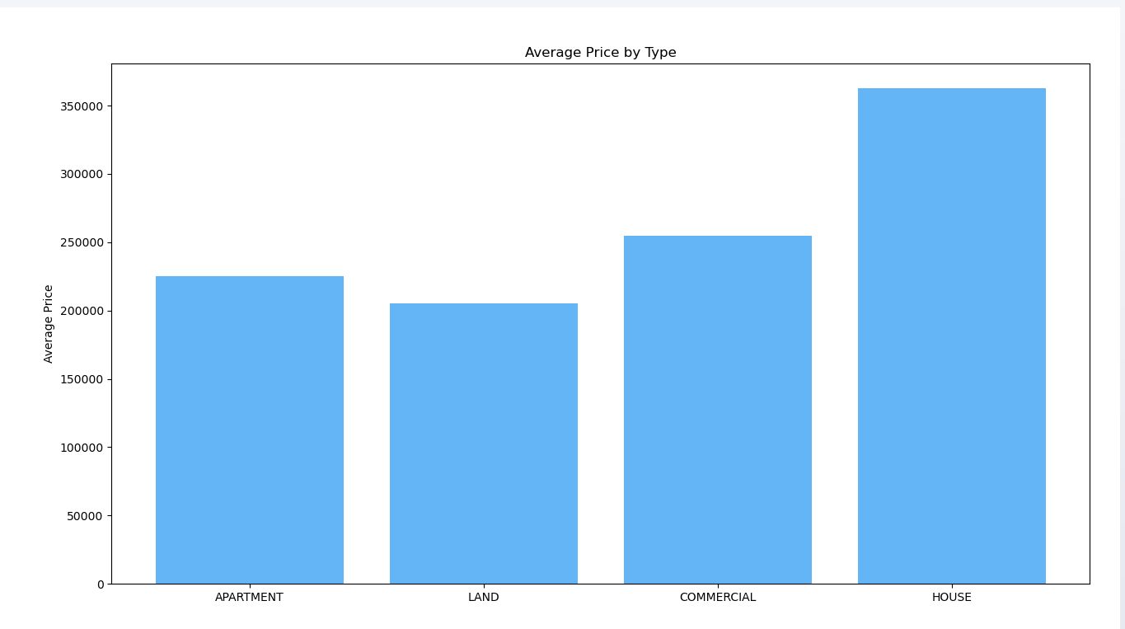
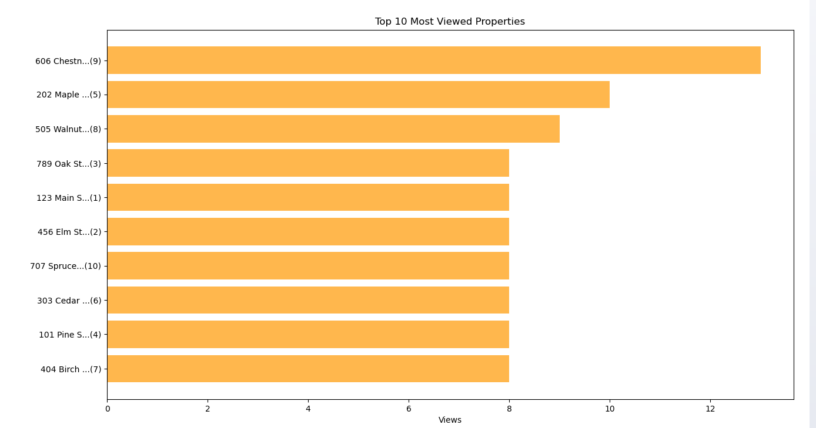
GUI & Visualization
Modern, Intuitive GUI Built with PyQt5
Form Dialogs：User adds property and client via popup form
Tab-Based UI
(main interface / AVL tree structure / data analysis)
Built-in Data Analytics
Log Panel：Automatic output of operation records for easy debugging and tracing
Property Type Distribution
Transaction Rate
AVL Tree Visualization
Average Price by Type
Top 10 Viewed Properties

Slide 11

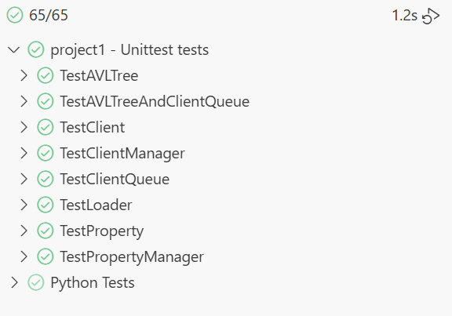
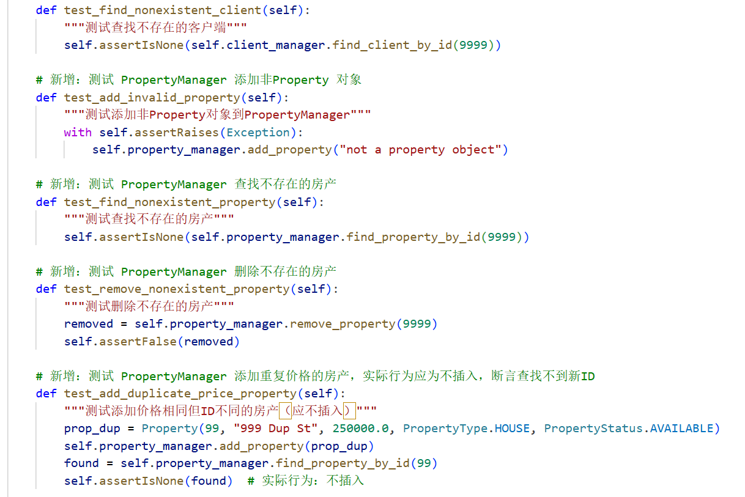
Testing & Robustness
Comprehensive Unit Testing
Coverage of Core Modules:
All key modules—including ClientQueue, AVLTree, PropertyManager, and ClientManager—are covered by unit tests.
Edge Case Testing:
Edge conditions like duplicate clients, invalid property actions, and queue boundary behavior are explicitly tested.
Visual Testing of AVL Tree:
Console-based AVL Tree visualization was integrated to manually verify tree balance and rotation logic.
e.g.(test_client_manager)

Slide 12


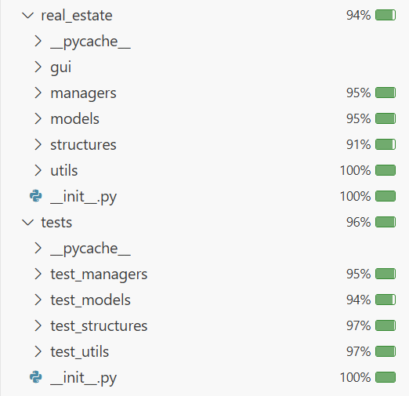
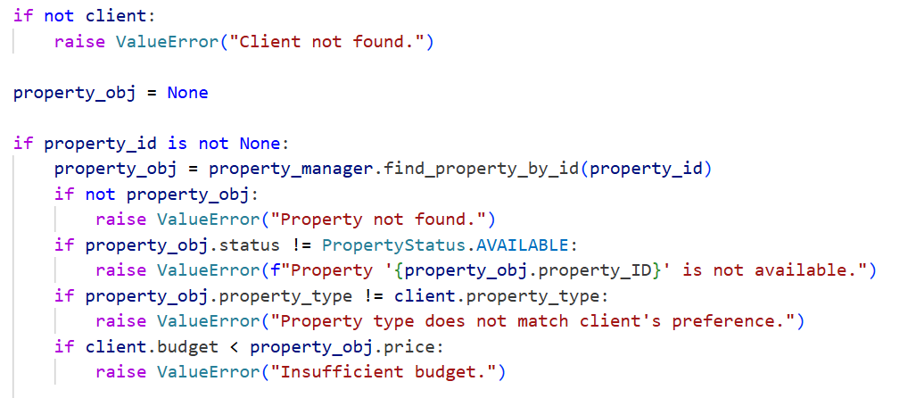
Testing & Robustness
High Code Coverage
Robustness by Design
Measured via Coverage Tools(Code Coverage)
Strict Input Validation:
Business logic checks for status, ownership, and budget to avoid invalid states.
PropertyManager.update_status()
ClientManager.buy_property()
Exception Handling:
Meaningful exceptions are raised for invalid operations
Coverage is almost 95% in all cases

Slide 13
Thanks for your time!

